Slide 1
Spring Object/XML mapping using Castor XML binding framework – XML Configuration
Using the Spring’s Object/XML Mapping, we can convert Object to XML or vice verse
XML Marshalling – Convert Object to XML.
XML UnMarshalling – Convert XML to Object.

Slide 2
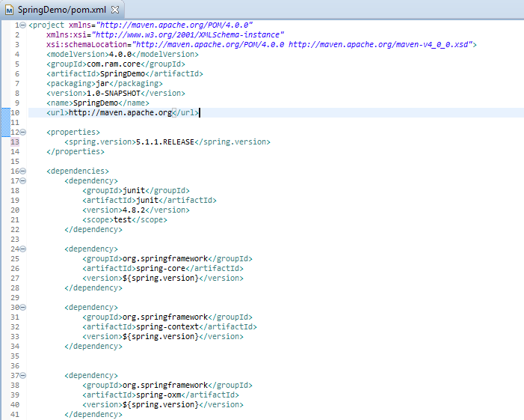
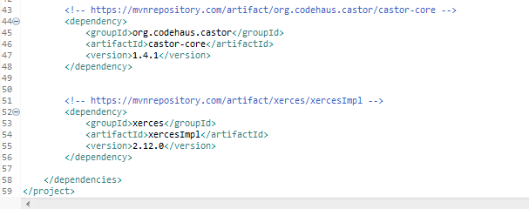
Spring Object/XML mapping using Castor XML binding framework – XML Configuration
Spring’s oxm itself doesn’t handle the XML marshalling or UnMarshalling, it depends developer to inject their prefer XML binding framework. In this case, we are using Castor binding framework.

Slide 3
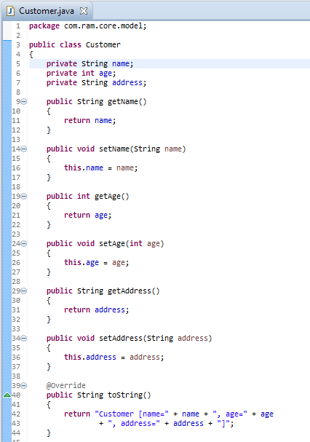
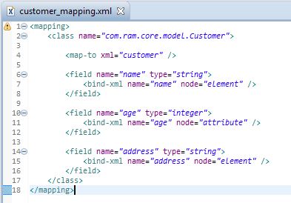
Spring Object/XML mapping using Castor XML binding framework – XML Configuration
We can use Castor XML mapping to define the relationship between Object and XML.

Slide 4
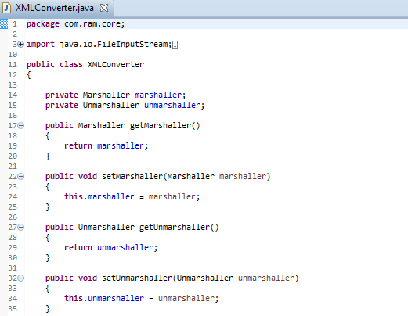
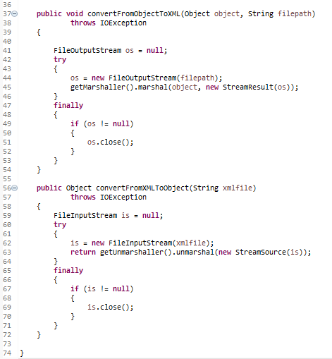
Spring Object/XML mapping using Castor XML binding framework – XML Configuration

Slide 5
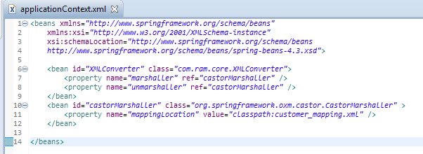
Spring Object/XML mapping using Castor XML binding framework – XML Configuration
In Spring’s bean configuration file, inject CastorMarshaller as the XML binding framework.

Slide 6
Spring Object/XML mapping using Castor XML binding framework – XML Configuration
Add for caster property

Slide 7
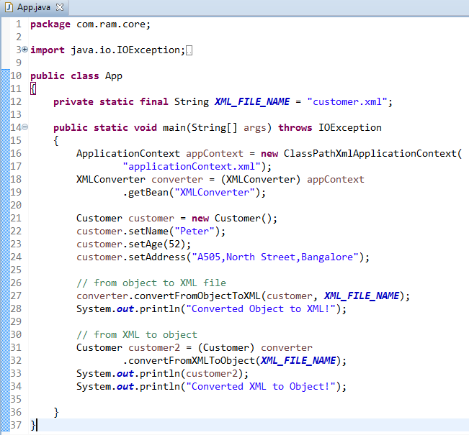
Spring Object/XML mapping using Castor XML binding framework – XML Configuration

Slide 8
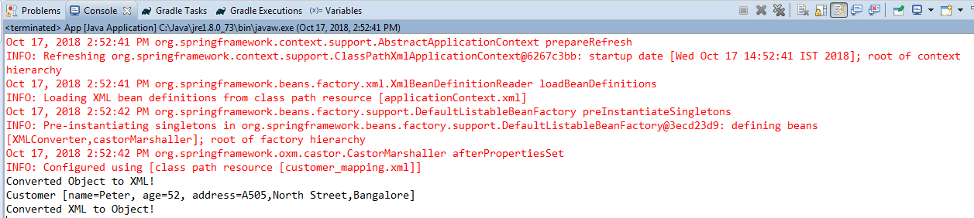
Spring Object/XML mapping using Castor XML binding framework – XML Configuration
“customer.xml” is generated in your project root folder

